Slide 1
Towards the 3rd 90: Factors associated with adherence and viral suppression among adolescents in Siaya County, Kenya
Paul Wekesa MBchB, PhD

Slide 2
CDC support acknowledgement:
“This project has been supported [in part] by the President’s Emergency Plan for AIDS Relief (PEPFAR) through the Centers for Disease Control and Prevention (CDC) [under the terms of [GH001946]].”
CDC authorship disclaimer:
"The findings and conclusions in this report are those of the author(s) and do not necessarily represent the official position of the funding agencies."

Slide 3
Outline
Background
Methods
Results
Conclusions
Limitations
Recommendations
References
Acknowledgement

Slide 4

Background
Adolescents are at the centre of the global HIV epidemic
Globally AIDS-related deaths declined by 32% in other age groups but increased by 50% among adolescents (Idele et al., 2014)
The adolescent HIV epidemic continues to be fueled as children with vertically transmitted HIV transition to adolescence (Barungi et al., 2015)
Sub-Saharan Africa is disproportionately affected with 85% of the burden, particularly in Southern and Eastern Africa (Idele et al., 2014)
In Kenya, an estimated 29% of new HIV infections are among adolescents and youth (MoH, 2015)

Slide 5
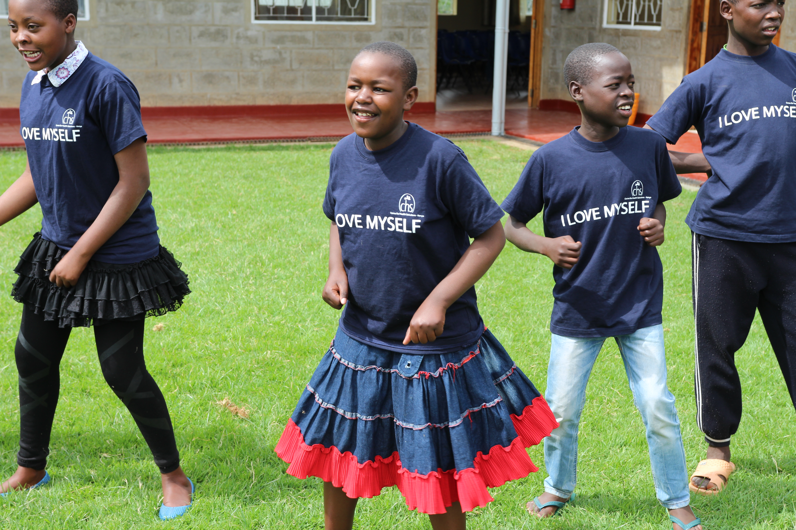
Background
Adolescence is associated with unique psychosocial and health needs
Need for autonomy, risk-taking behavior, peer influence could affect management of adolescents living with HIV (ALHIV) (Adejumo et al., 2015)
Suboptimal adherence and viral suppression is more likely among adolescents affecting future treatment options (Yang et al., 2017)
We sought to investigate predictors of adherence and viral suppression among ALHIV in Siaya, Kenya

Slide 6
Methods
Retrospective cohort analysis of 2814 adolescent records receiving care at 119 health facilities (initiating ART between 2000 and 2017)
Variables included: age, sex, sub county, ART regimen, viral load, self reported adherence (SRA), frequency of clinic visits, caregiver SRA, caregiver HIV status, caregivers attendance of support groups, and stable caregiver
Bivariate analyses was done using chi square tests
Multivariable binary logistic regression analysis was performed to evaluate outcomes reporting Odds ratios (OR) and 95% confidence intervals

Slide 7
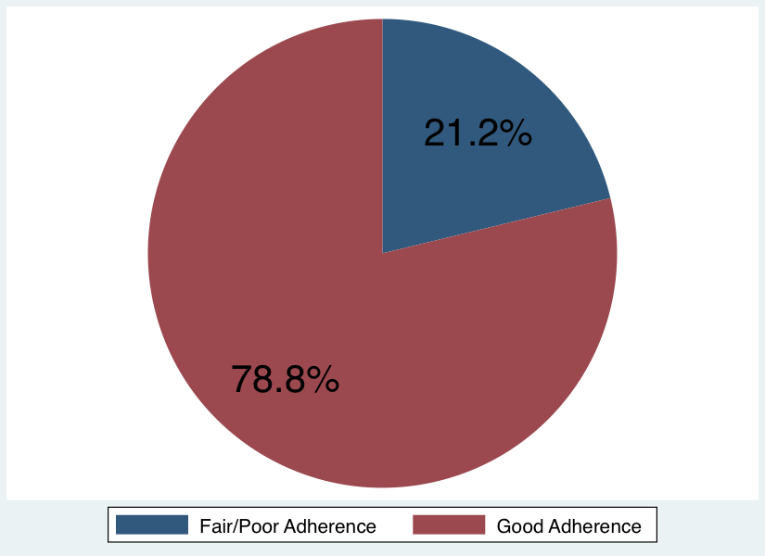
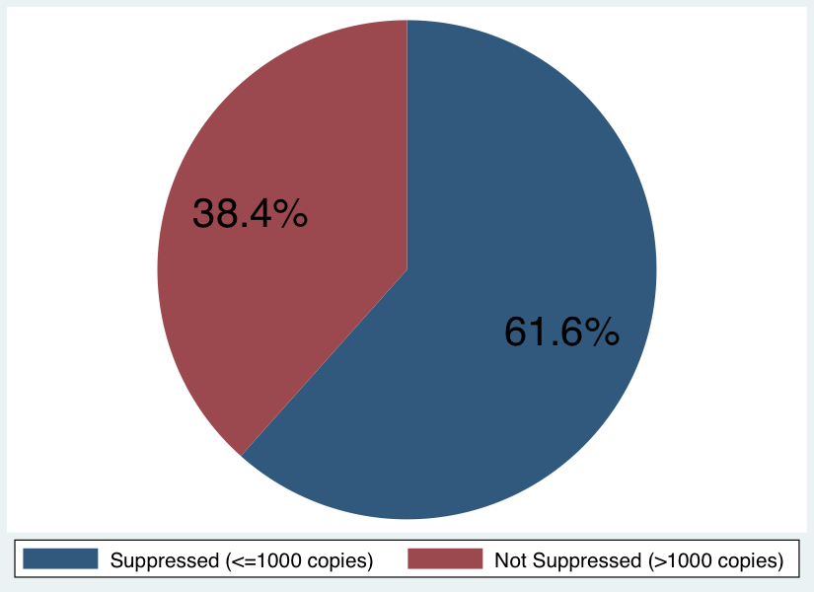
Results
Analysis sample included 2,814 adolescents
Demographics
Slightly over half of adolescents were female 2934 (52.8%)
Majority were from Gem and Bondo sub Counties; 687 (24.4%) and 660 (23.4%) respectively
Mean age of 13.3 years (SD = 2.7); Range (10-19 years)
Outcomes
Majority had good self reported adherence, 2192 (78.8%)
389 (14%) and 201 (7.2%) had Fair and Poor self reported adherence respectively
Over half, 1615 (61.6%) had viral suppression (<=1000 copies)

Slide 8
Results
Caregivers
A total of 1,568 (55.7%) attended support groups
Half were HIV positive 1,440 (51%)
Of these 1,425 (99%) were on ART
Of these 1,087 (88%) reported good adherence

Slide 9
Bivariate Analyses (Selected Variables)

Slide 10
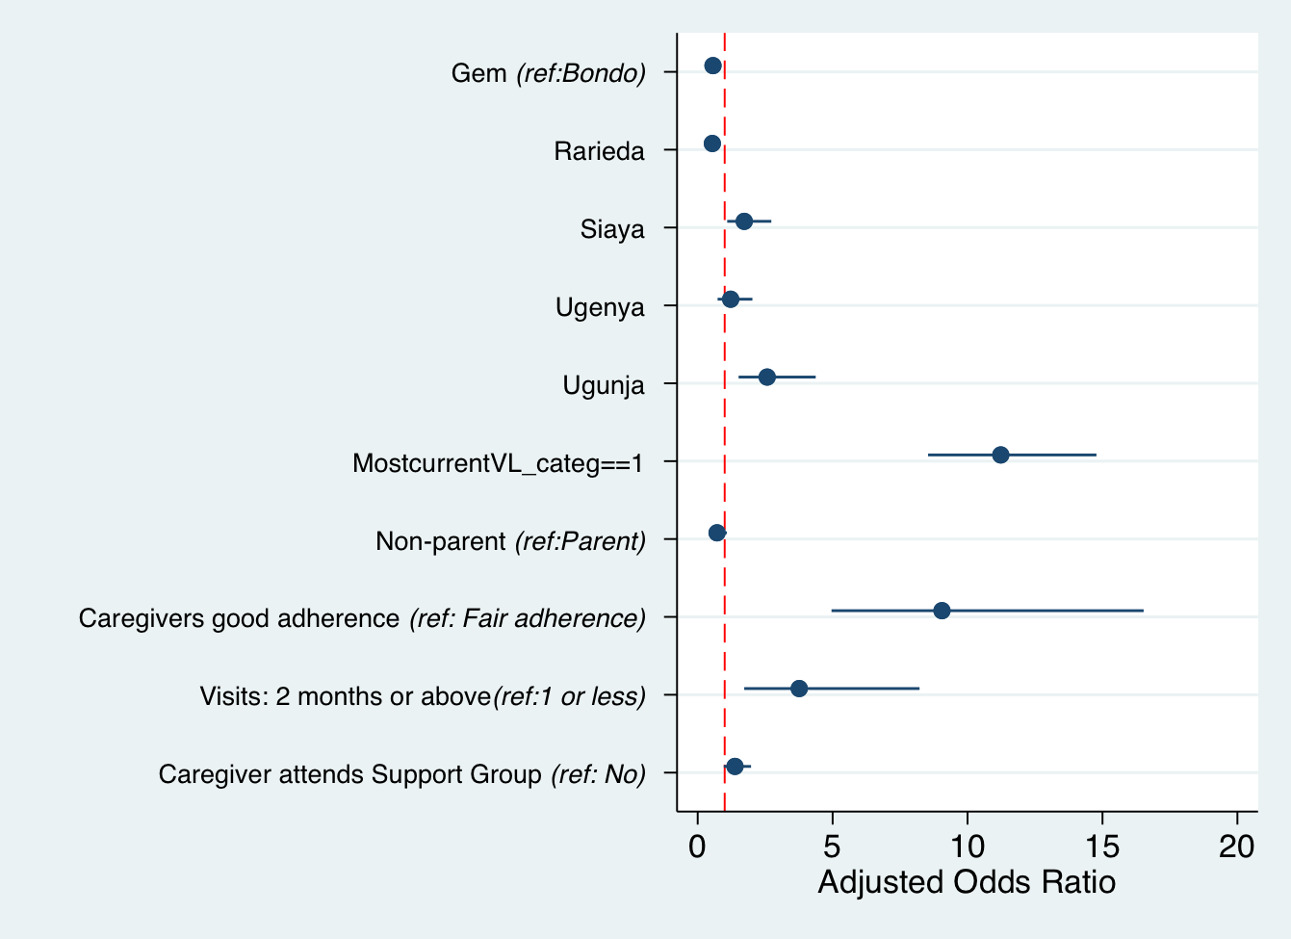
Adherence Model

Slide 11
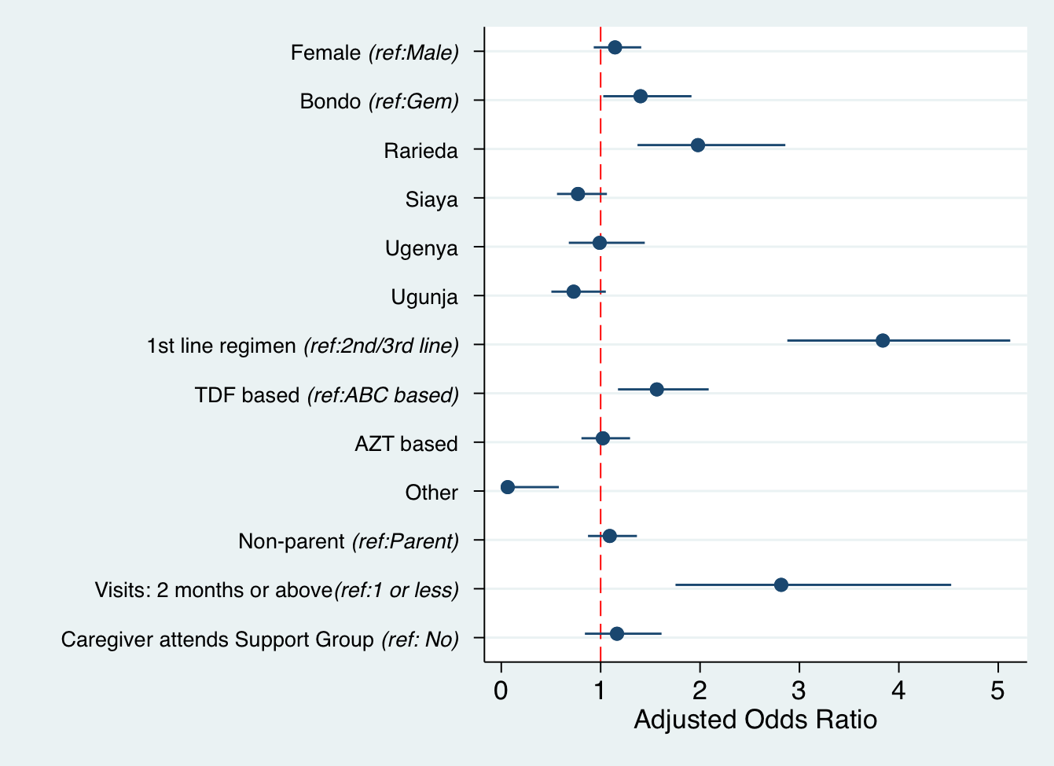
Viral Suppression Model

Slide 12
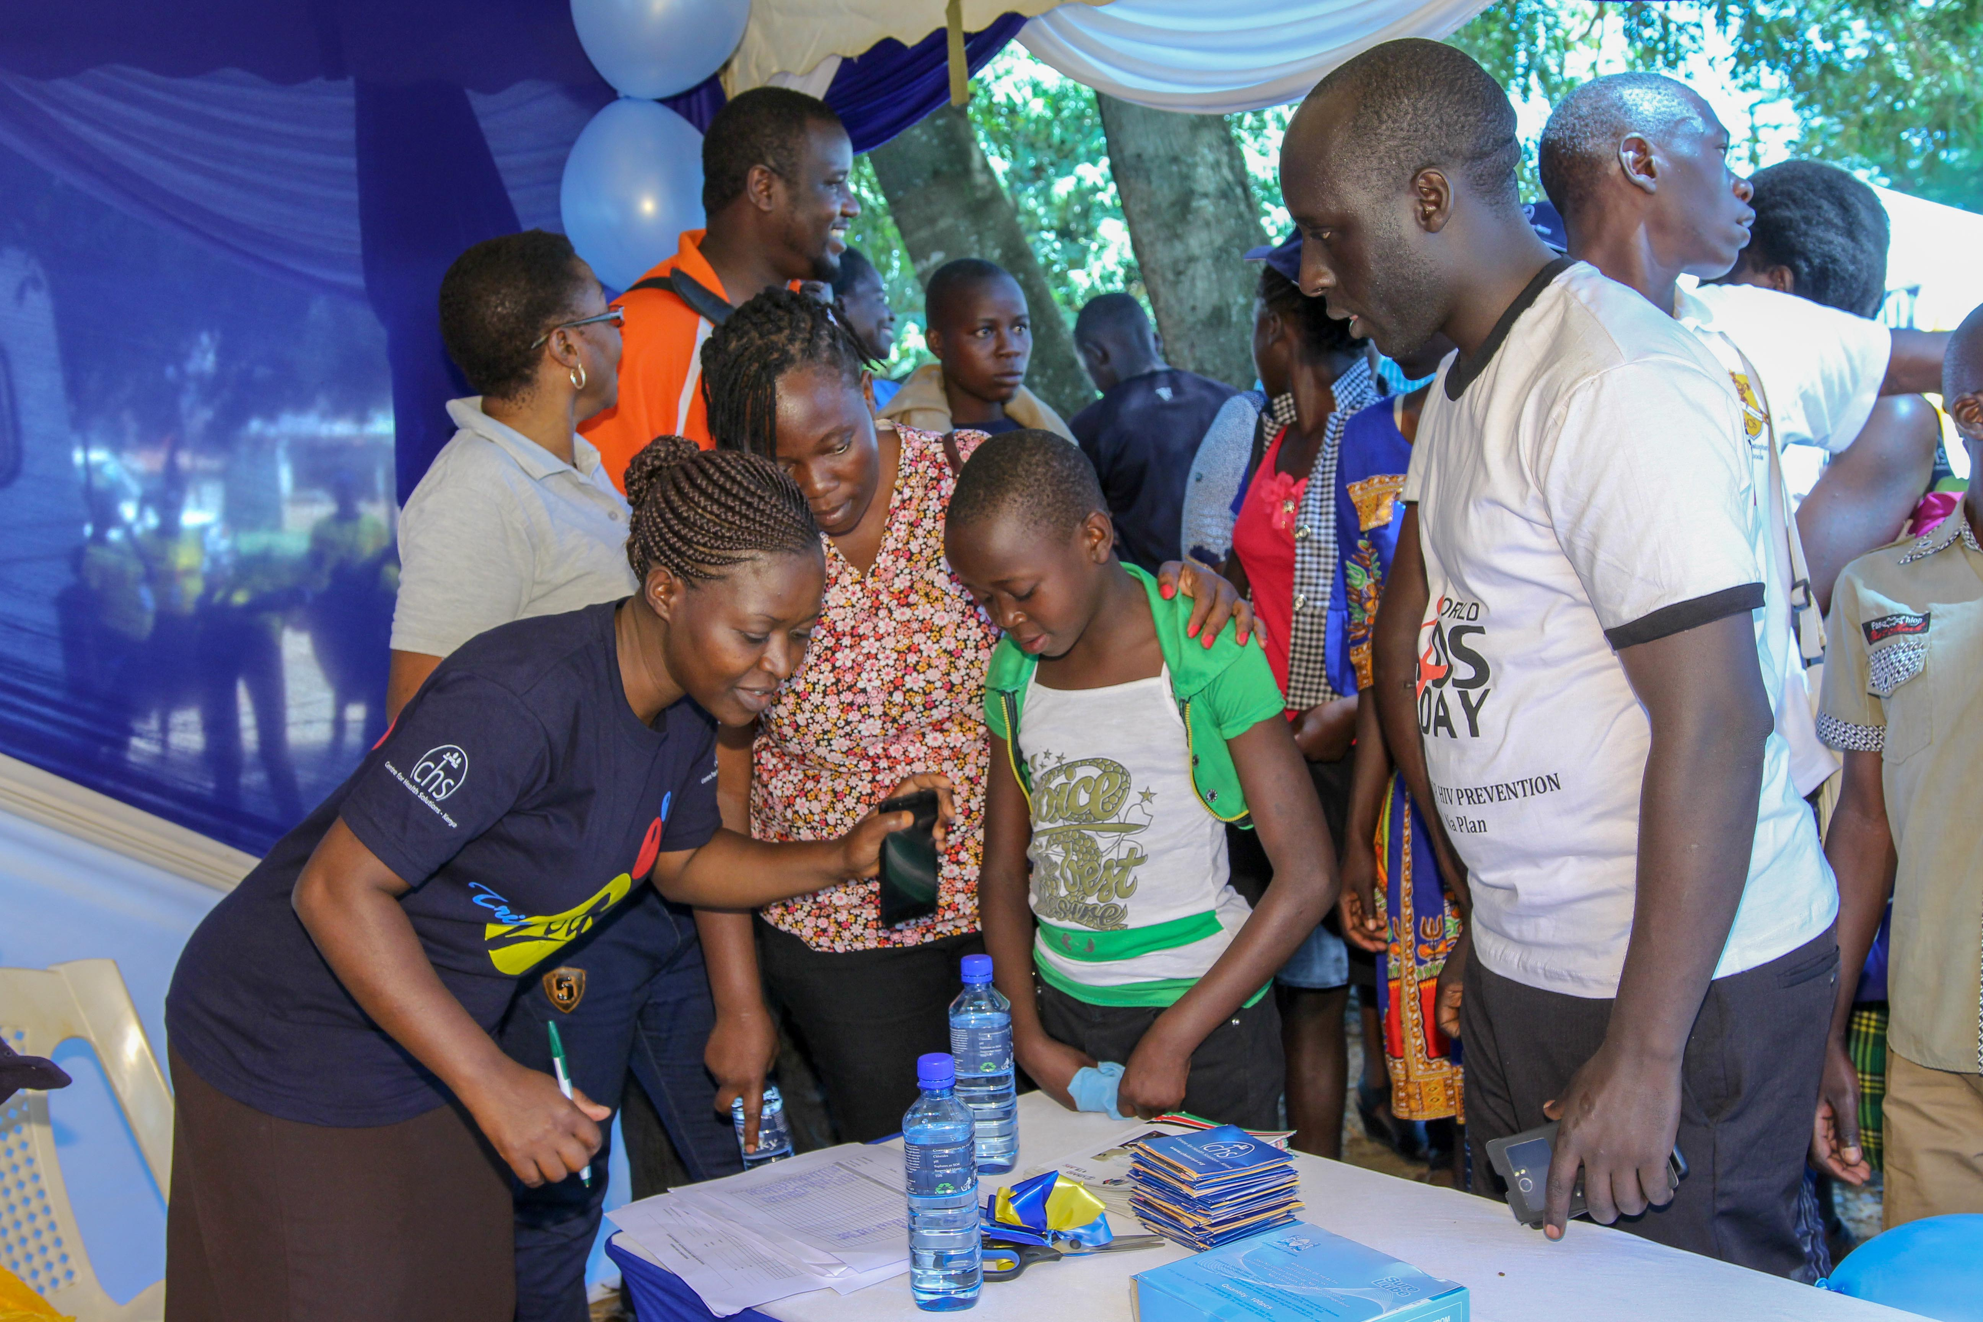
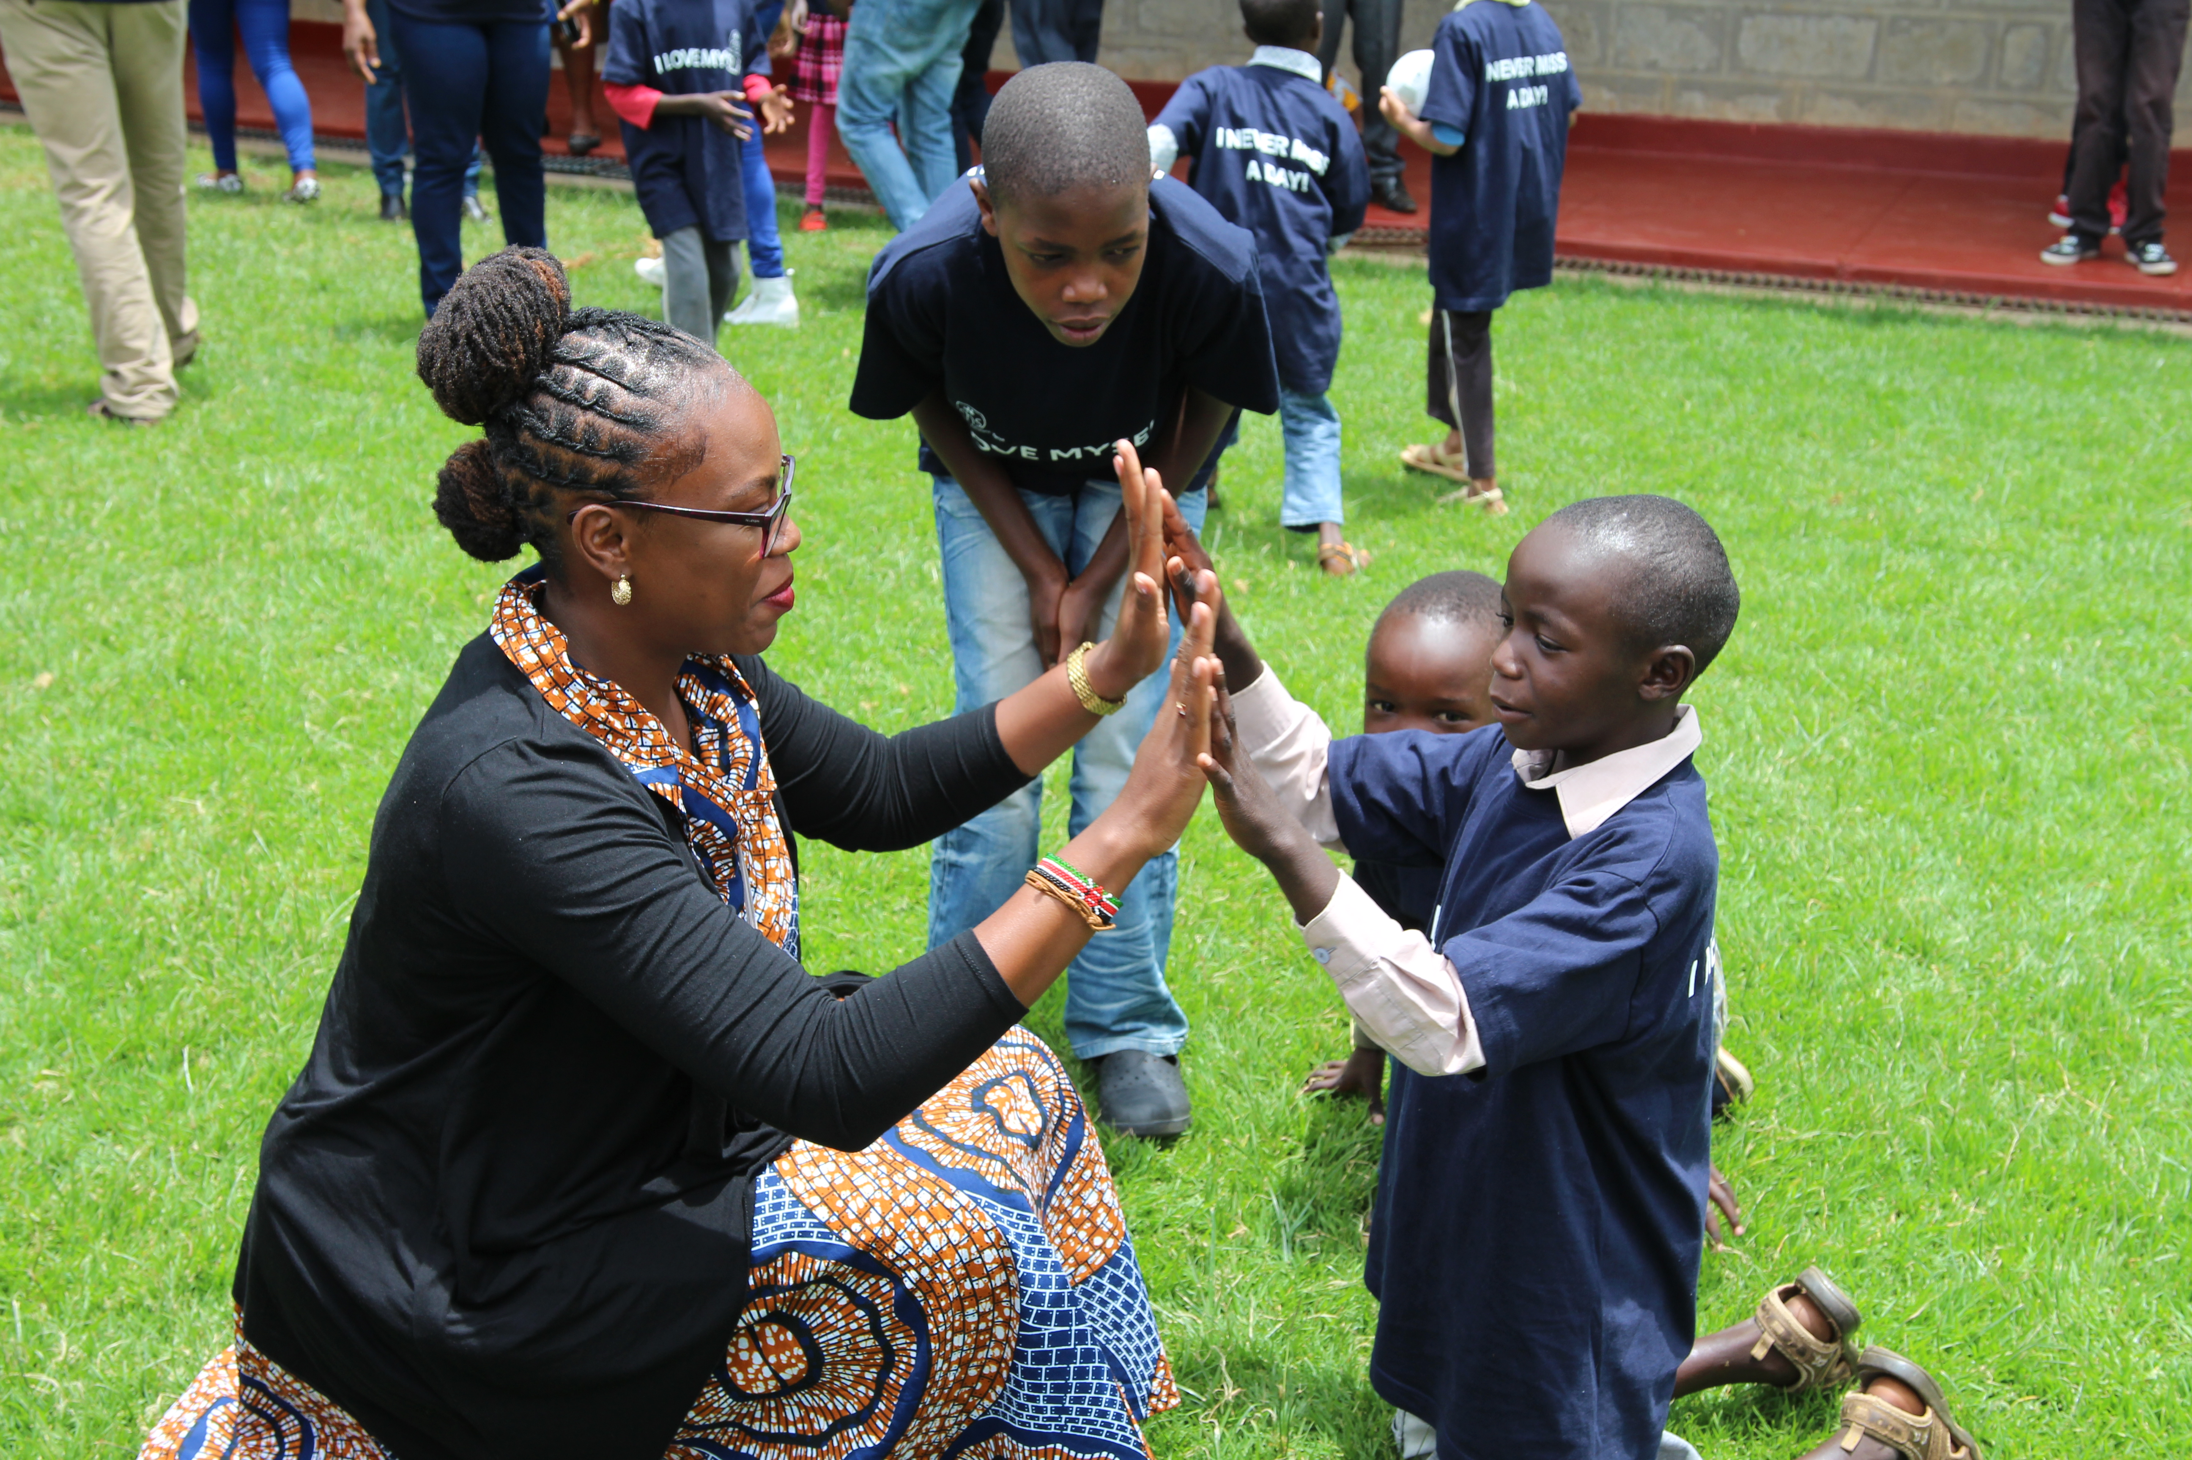
Conclusion
Good adherence among adolescents was associated with viral suppression (11x), caregivers’ good SRA (9X), region (3 and 4x – Siaya and Ugunja) and frequency of clinic visits (3x)
Viral suppression among adolescents was associated with good SRA (11x), clinic visit intervals of 2 months or more (2.8x), region (Rarieda 1.9x) and Regimen (2nd/3rd line -3.8x/Tenofovir-based ART regimens -1.5x)

Slide 13
Limitations
Use of self reported adherence was a limitation, since this is inferior to gold standard
We used cross-sectional viral load results and therefore did not measure effect over time
We did not adjust for duration on ART and mode of HIV transmission
Use of retrospective data

Slide 14
Recommendation
Prospective evaluation of the effect of these factors over time to inform implementation strategies

Slide 15
References
Adejumo, O. A., Malee, K. M., Ryscavage, P., Hunter, S. J., & Taiwo, B. O. (2015). Contemporary issues on the epidemiology and antiretroviral adherence of HIV‐infected adolescents in sub‐Saharan Africa: a narrative review. Journal of the International AIDS Society, 18(1), 20049.
Idele, P., Gillespie, A., Porth, T., Suzuki, C., Mahy, M., Kasedde, S., & Luo, C. (2014). Epidemiology of HIV and AIDS among adolescents: current status, inequities, and data gaps. JAIDS Journal of Acquired Immune Deficiency Syndromes, 66, S144-S153.
Ministry of Health (2015). Kenya’s fast track plan to end HIV and AIDS among adolescents and young people. Retrieved from http:www.nacc.co.ke.
Nabukeera-Barungi, N., Elyanu, P., Asire, B., Katureebe, C., Lukabwe, I., Namusoke, E., ... & Tumwesigye, N. (2015). Adherence to antiretroviral therapy and retention in care for adolescents living with HIV from 10 districts in Uganda. BMC infectious diseases, 15(1), 520.
Yang, E., Mphele, S., Moshashane, N., Bula, B., Chapman, J., Okatch, H., ... & Lowenthal, E. (2017). Distinctive barriers to antiretroviral therapy adherence among non-adherent adolescents living with HIV in Botswana. AIDS care, 1-8.

Slide 16
Acknowledgments
Participating adolescents
Health facilities staff in Siaya County
Siaya County Department of Health
CDC
CHS

